Slide 1

Avinashilingam Institute for Home Science and Higher Education for Women Deemed to be University Estd. u/s 3 of UGC Act 1956, Category A by MHRD [now MoE] Re-accredited with A++ Grade by NAAC. CGPA 3.65 /4, Category I by UGC
Coimbatore - 641 043, Tamil Nadu, India
SCHOOL OF ENGINEERING
DEPARTMENT OF COMPUTER SCIENCE AND ENGINEERING
HSL-FUSED VISION TRANSFORMER FOR MICROPLASTIC IDENTIFICATION 21BEOC32 – RESEARCH PROJECT PHASE -II
Guided By:
Mrs. M. Minu Sunitha Mary B.E,M.E, Assistant Professor / CSE
Date of Presentation:30.04.2026
PRESENTED BY
Nirajitha M(22UEO035)
Pavithra M(22UEO040)
Swetha M(22UEO056)
Swetha S(22UEO058)
1

Slide 2
OVERVIEW
INTRODUCTION
LITERATURE REVIEW
PROBLEM STATEMENT
OBJECTIVES
PROPOSED SYSTEM
BLOCK DIAGRAM
TECHNICAL SPECIFICATIONS
METHODOLOGY
CONCLUSION AND FUTURE ENHANCEMENTS
PUBLICATION
REFERENCES
2

Slide 3
INTRODUCTION
Uses Digital Holographic Microscopy(DHM) to capture amplitude and phase images of samples particularly transparent objects like living cells.
Applies HSL color space fusion for richer image representation.
Employs a Vision Transformer (ViT) model with hyperparameter tuning and data augmentation.
Evaluates performance using accuracy, precision, recall, F1-score,AUC, and ROC curves.
Deploys the trained model in a Flask web app for real-time classification.
Provides confidence scores and heatmaps to determine the accuracy of field extraction for automation.

Slide 4
LITERATURE REVIEW
S.NO | AUTHORS AND YEAR | TITLE OF THE PAPER | METHODOLOGY | INFERENCE
1. | S. Chokchaitam et al. (2024) | Enhancing Automatic Microplastic Detection Through Density Separation and HSV Color Processing | Combined density separation with HSV color-based image processing for automated microplastic detection | Automated detection framework validated against expert observations. Limitations: HSV sensitivity affected by lighting.
2. | Primpke, S., et al. (2023) | Automated Microplastic Identification via FTIR Imaging and Machine Learning | Combined FTIR spectroscopy with machine learning classifiers for automated microplastic detection | Reduced manual analysis time and improved classification reliability. Limitations: Dependent on FTIR data quality.

Slide 5
3. | Coronel-León, J., et al. (2023) | Computer Vision for Microplastic Detection in Marine Samples | Applied CNN-based classification on microscopic RGB images with preprocessing and augmentation. | Enhanced detection accuracy in complex marine backgrounds. Limitations: CNN may struggle with non-marine samples.
4. | Maes, T., et al. (2022) | Advances in Optical Imaging for Microplastic Detection | Reviewed multiple optical imaging techniques, emphasizing multimodal approaches. | Combining imaging modalities can improve classification accuracy. Limitations: Focuses on optical imaging.
5. | Park, H., et al. (2022) | High-Resolution Imaging and Deep Learning for Microplastic Classification | Used high-resolution microscopy images with ResNet-based CNN model. | Achieved high classification accuracy on lab datasets. Limitations: Needs high- res equipment.

Slide 6
6. | Rochman, C. M., et al. (2021) | Machine Learning for Microplastic Pollution Monitoring | Applied ML to process large-scale image datasets for microplastic monitoring. | Showed scalability for environmental monitoring. Limitations: ML needs diverse data and real time images.
7. | Xu, Y., et al. (2021) | Vision-Based Identification of Microplastics Using DCNN | Used deep CNNs to classify microplastics in mixed debris samples. | Managed variability in shape and color with reasonable accuracy. Limitations: DCNN needs robust training data.
8. | Erni-Cassola, G., et al. (2020) | AI for Environmental Microplastic Analysis | Proposed integrating AI with spectroscopy and imaging for automated analysis. | Enabled high-throughput and fully automated microplastic identification. Limitations: Automation depends on data pipeline.

Slide 7
PROBLEM STATEMENT
Existing models struggle to distinguish microplastics from complex backgrounds.
Microplastic pollution in water threatens ecosystems and human health.
Manual and traditional image processing methods are slow, error-prone, and not scalable.
Lack of rich image representation limits classification accuracy.

Slide 8
OBJECTIVES
To design a real-time microplastic detection system using HSL color space fusion with the Vision Transformer (ViT) architecture to perform accurate classification of water samples.
Collect and pre-processes amplitude and phase images, enhance the feature representation
with Digital Holographic Microscopy(DHM).
Deploy the trained model as a Flask-based web application confidence scores and
interpretability via heatmaps.

Slide 9
PROPOSED SYSTEM
Component | Working
Data Collection | Aggregates microscopic image datasets featuring microplastics of various shapes, sizes, and textures found in environmental samples.
Preprocessing & Noise Reduction | Uses Digital Holographic Microscopy(DHM) to image resizing, normalization, and noise reduction to standardize input data and improve training reliability.
HSL Color Enhancement | Transforms images into the Hue, Saturation, Lightness (HSL) color space to better separate color features and distinguish microplastics from background noise.
Feature Extraction | Employs a Vision Transformer (ViT) architecture that applies multi-head self-attention to extract deep features.
Performance Evaluation | Measures the model's ability to provide more consistent, accurate, and efficient detection compared to manual or conventional processing methods.
Inference & Prediction | Processes new or real-time microscopic images to predict the presence and classification of microplastic particles.

Slide 10
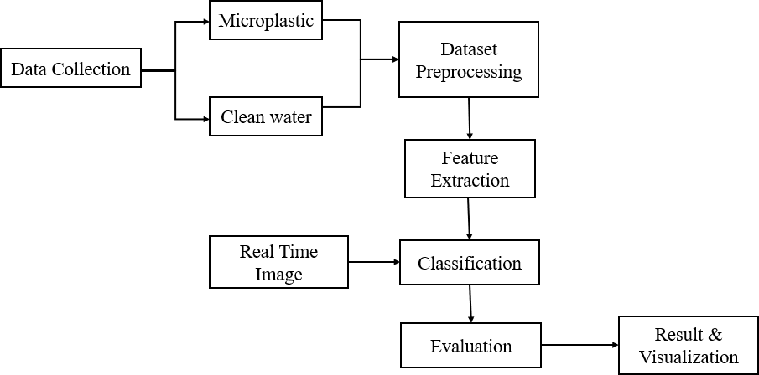
BLOCK DIAGRAM

Slide 11
Data Collection - Gather labeled microplastic images from Kaggle.
Preprocessing - Resize, apply HSL image fusion, remove noise, normalize, and augment
images.
Feature Extraction- ViT splits images into patches to extract feature.
Classification- The pre-processed features are used to classify the input(microplastics vs
clean water).
Evaluation - Measure performance using accuracy, precision, recall, F1-score, AUC, and ROC.
Result and Visualization- Present the outcomes and visual representation of images
using flask web application.

Slide 12
TECHNICAL SPECIFICATIONS
SOFTWARE SPECIFICATION
S.No | Technology | Specification
1 | Core | Python, HTML5, CSS, Javascript(Front-end for Flask UI)
2 | Framework | Flask (for deployment)
3 | Deep Learning Framework | PyTorch (Vision Transformer Model)
4 | Libraries | TorchVision, NumPy, Pandas, Pillow, OpenCV
5 | Algorithm | HSL-Fused Vision Transformer (ViT-B/16)
6 | Dataset Format | Clean Water vs Microplastic Image Dataset
7 | Model Weights | ImageNet Pretrained ViT model
8 | Environment | VS Code for development

Slide 13
TECHNICAL SPECIFICATIONS
HARDWARE SPECIFICATION
S.No | Technology | Specification
1 | Processor (CPU): | Intel Core i5 or i7 (10th Gen or higher) / AMD Ryzen 5 or 7
2 | Memory (RAM) | 8 GB to 16 GB
3 | Graphics Processing Unit (GPU): | NVIDIA GeForce GTX 1650 or higher (with CUDA support)
4 | Storage | 250GB of available SSD space

Slide 14
METHODOLOGIES
MODULE 1: Data Collection from Kaggle
MODULE 2: Preprocessing Microplastic Datasets
MODULE 3: Feature Extraction of Microplastic Images MODULE 4: Classification of Microplastic Images MODULE 5: Evaluation of Classified Images MODULE 6: Result & Visualization

Slide 15
Module 1: Data Collection from Kaggle
The dataset was collected from Kaggle.
It contained images of microplastic particles and clean water samples.
The images were organized for binary classification: Microplastic vs Non-Microplastic.
The dataset was split into training, validation, and testing sets.
It was open-source, pre-labeled, and reliable for microplastic detection research.

Slide 16
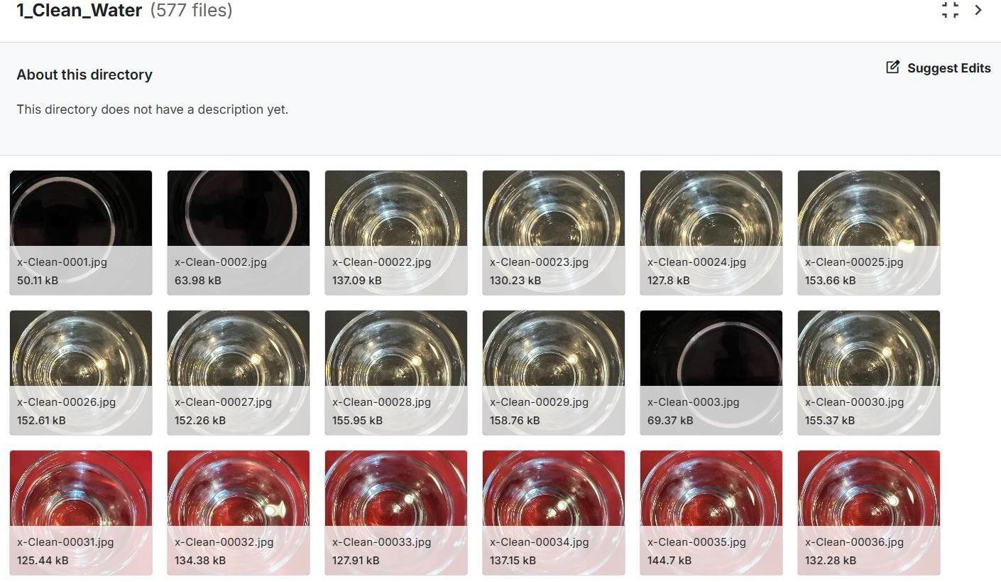
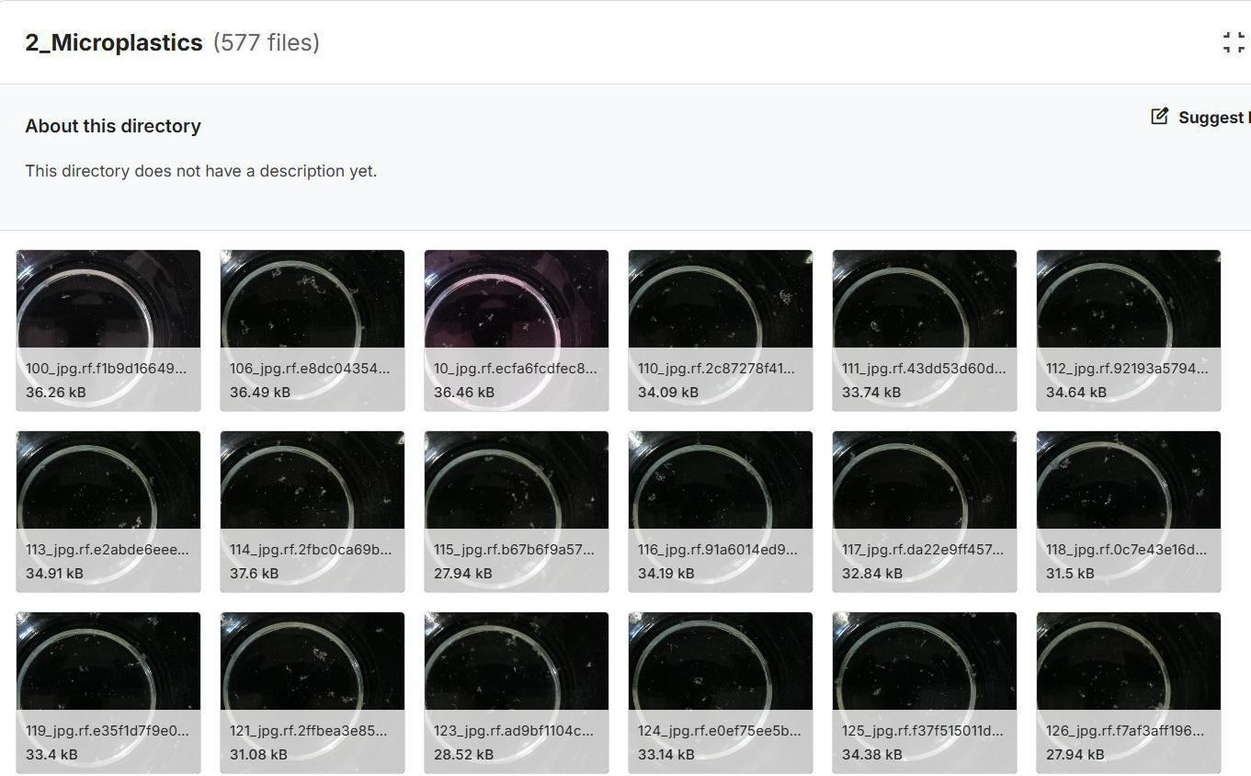
Fig 1: Data Collection from Kaggle

Slide 17
Module 2: Preprocessing of Microplastic Datasets
The collected images were resized into a fixed dimension.
The pixel values were normalized for consistency.
Noise and unwanted background details were removed.
Images were converted from RGB to HSL color space for better feature
representation.
The preprocessed dataset was prepared for feature extraction.

Slide 18
Module 3: Feature Extraction of Microplastic Images
HSL-fused images are divided into fixed-size patches for processing.
Each patch is embedded into a token sequence with positional encoding.
Vision Transformer applies multi-head self-attention to extract deep features.
Extracted features capture texture, shape, and color patterns of microplastics.

Slide 19
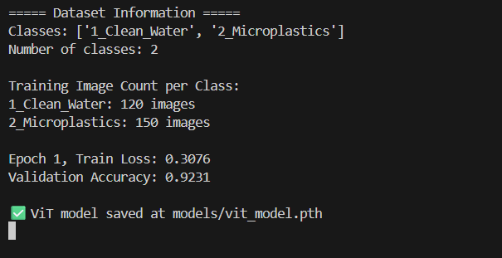
Fig 2: Feature Extraction from ViT Model

Slide 20
Module 4: Classification of Microplastic Images
Features are passed to the ViT classification head for binary classification.
Labels are assigned as Microplastic or Non-Microplastic.
Hyperparameters like learning rate and batch size are tuned for optimal performance.
Data augmentation improves model generalization and reduces overfitting.

Slide 21
Module 5: Evaluation of Classified Images
Evaluates the performance of the trained Vision Transformer model.
The classified images are analyzed to measure how accurately
the model
identifies
Evaluation calculated.
microplastics.
metrics such as accuracy, precision, recall, and F1-score are
ROC curve and AUC values are used to assess the model’s classification capability.

Slide 22
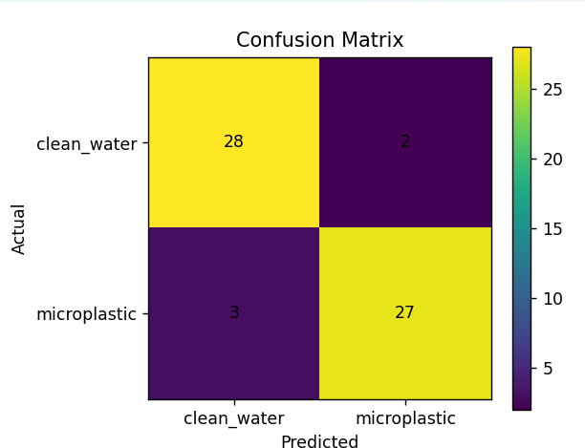
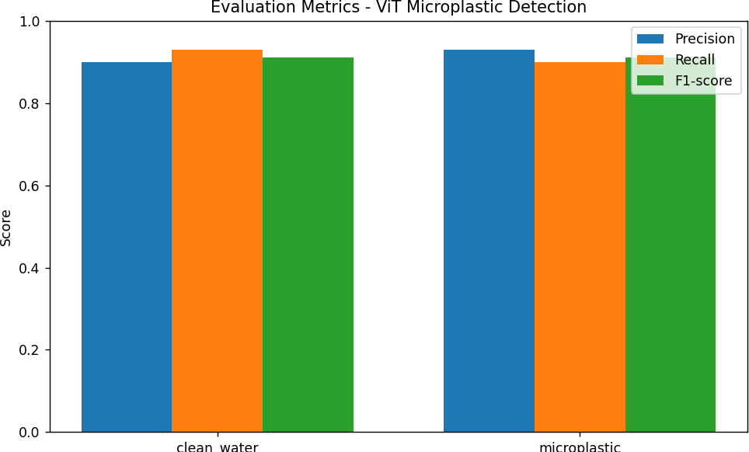
Fig 3:Evaluation Metrics and Confusion Matrix

Slide 23
Module 6: Result & Visualization
Displays the final output of the microplastic classification system.
Users upload microscopic images through a Flask-based web application.
The system predicts whether the image contains Microplastic
or Non-
Microplastic.
Heatmaps visualize the important regions used by the model for decision-making.
23

Slide 24
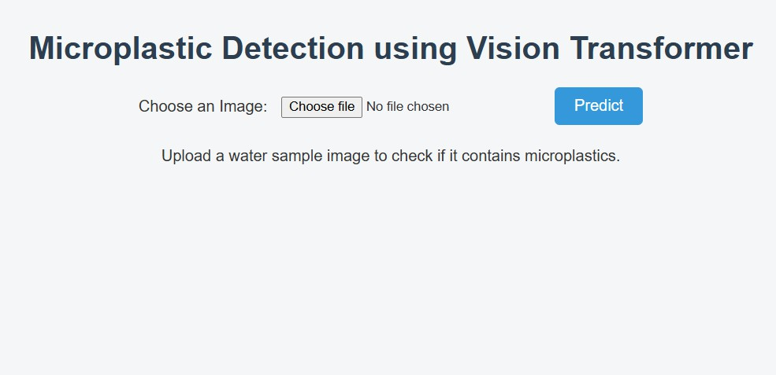

Slide 25
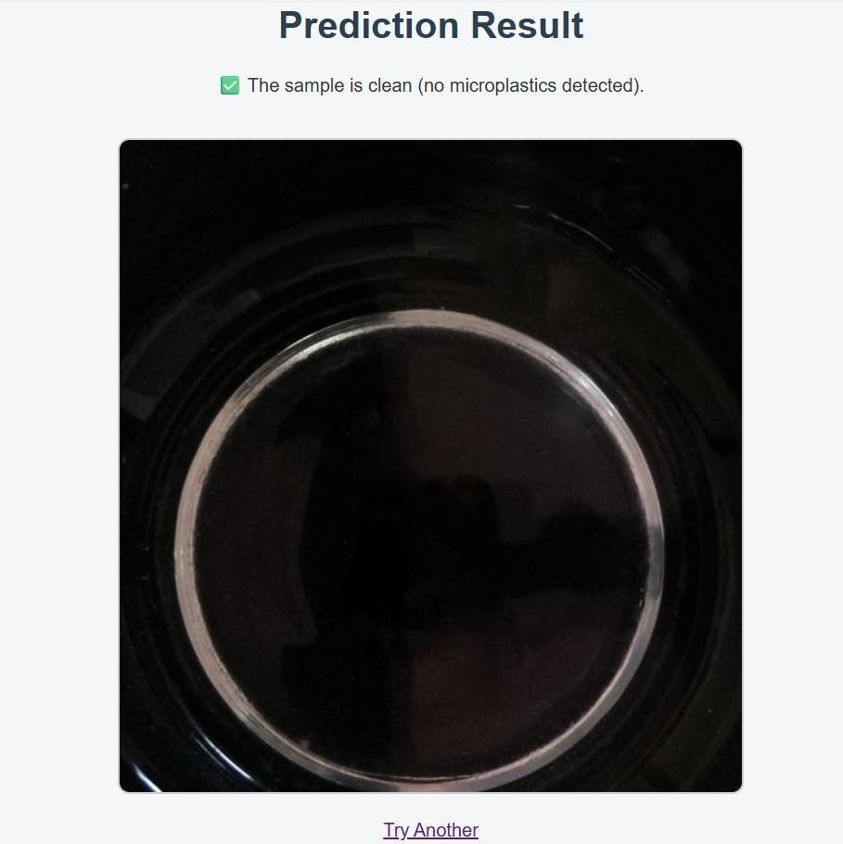
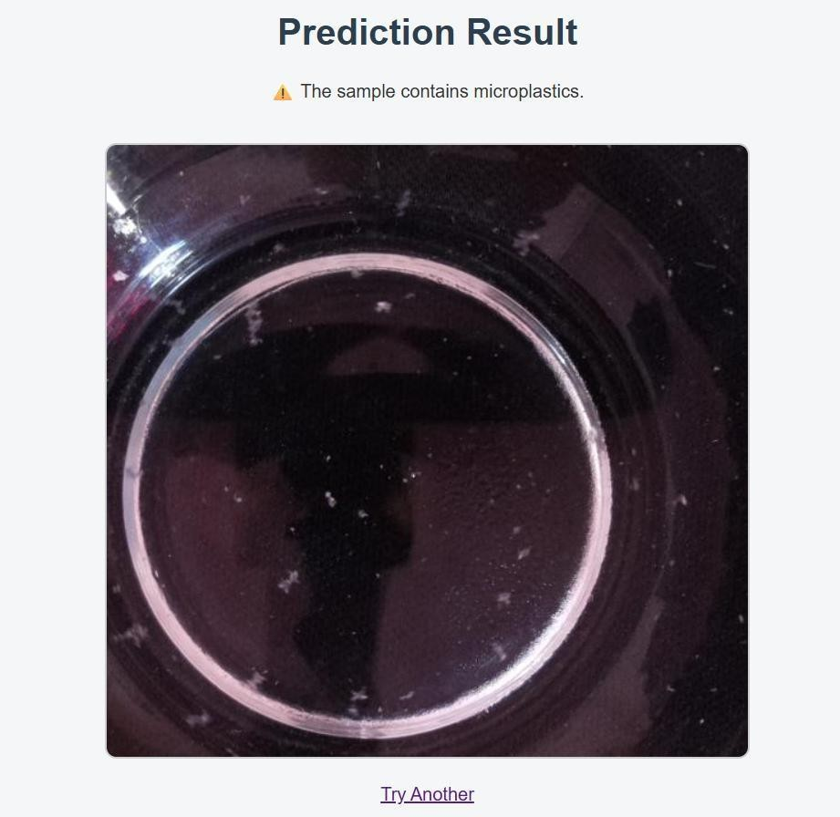
Fig 4: Result & Visualization

Slide 26
CONCLUSION
Develops a cutting-edge microplastic classification system by integrating HSL
image fusion with a Vision Transformer architecture.
Evaluates performance using key metrics: accuracy, precision, recall, F1-score,
AUC, and ROC curves.
Deploys as a Flask-based web application, enabling real-time, user-friendly
classification.

Slide 27
FUTURE ENHANCEMENTS
Connect digital microscopes directly with embedded systems for automated image capture.
Display detection results and attention heatmaps directly on portable devices.

Slide 28
PUBLICATIONS
CONFERENCE
Name of the Conference | National Conference on AI Applications in Electrical, Electronics and Computing Systems
Conference Organizers | Karpagam Institute of Technology, Coimbatore
Date of Conference | 1 April 2026
ISBN Number | 978-93-6228-226-2

Slide 29
JOURNAL
Paper Journal Publication | International Research Journal of Modernization in Engineering Technology and Science https://www.irjmets.com/
Volume/Issue | Volume 08/Issue 03/March 2026
e-ISSN Number | 2582-5208
DOI | 10.56726/IRJMETS52500

Slide 30
REFERENCES
S. Chokchaitam, P. Kaewprapha, W. Chainam, et al., “Enhancing Automatic Microplastic Detection Through Density Separation and HSV Color Processing,” International Conference on Robotics and Automation Sciences (ICRAS), 2024.
S. Primpke, et al., “Automated Microplastic Identification via FTIR Imaging and Machine Learning,”
FTIR Imaging and Analysis Journal, 2023.
J. Coronel-León, et al., “Computer Vision for Microplastic Detection in Marine Samples,” Marine Environmental Imaging Research, 2023.
Zhang, K., and Zhang, C. C. “A low-cost rover for microplastic detection using deep learning and near-
infrared spectroscopy.” IEEE Canadian Conference on Electrical and Computer Engineering, 2023.
T. Maes, et al., “Advances in Optical Imaging for Microplastic Detection,” Optical Imaging and Pollution Monitoring Review, 2022.
26

Slide 31
H. Park, et al., “High-Resolution Imaging and Deep Learning for Microplastic Classification,” International Journal of Environmental Deep Learning, 2022.
Razali, N. M., and Saris, N. N. H. “Optical planar waveguide sensor simulation for microplastic detection in water.” IEEE Numerical Simulation of Optoelectronic Devices Conference (NUSOD), 2022.
C. M. Rochman, et al., “Machine Learning for Microplastic Pollution Monitoring,” Environmental Data Science Journal, 2021.
Y. Xu, et al., “Vision-Based Identification of Microplastics Using DCNN,” International Conference on Vision-Based Environmental Analysis, 2021.
G. Erni-Cassola, et al., “AI for Environmental Microplastic Analysis,” Journal of Intelligent Spectroscopy and Imaging, 2020.

